Slide 1


ECE477 MIDTERM DESIGN REVIEW: TEAM #7
Yaodong Shen, Carol Lo, Yao Chen，Jia En Chua

Slide 2
OUTLINE
Project Overview
Major Components
Block Diagram
Packaging Design
Electrical Schematic
PCB Layout
Prototyping Progress
Software Development Status
Project Timeline
Questions

Slide 3
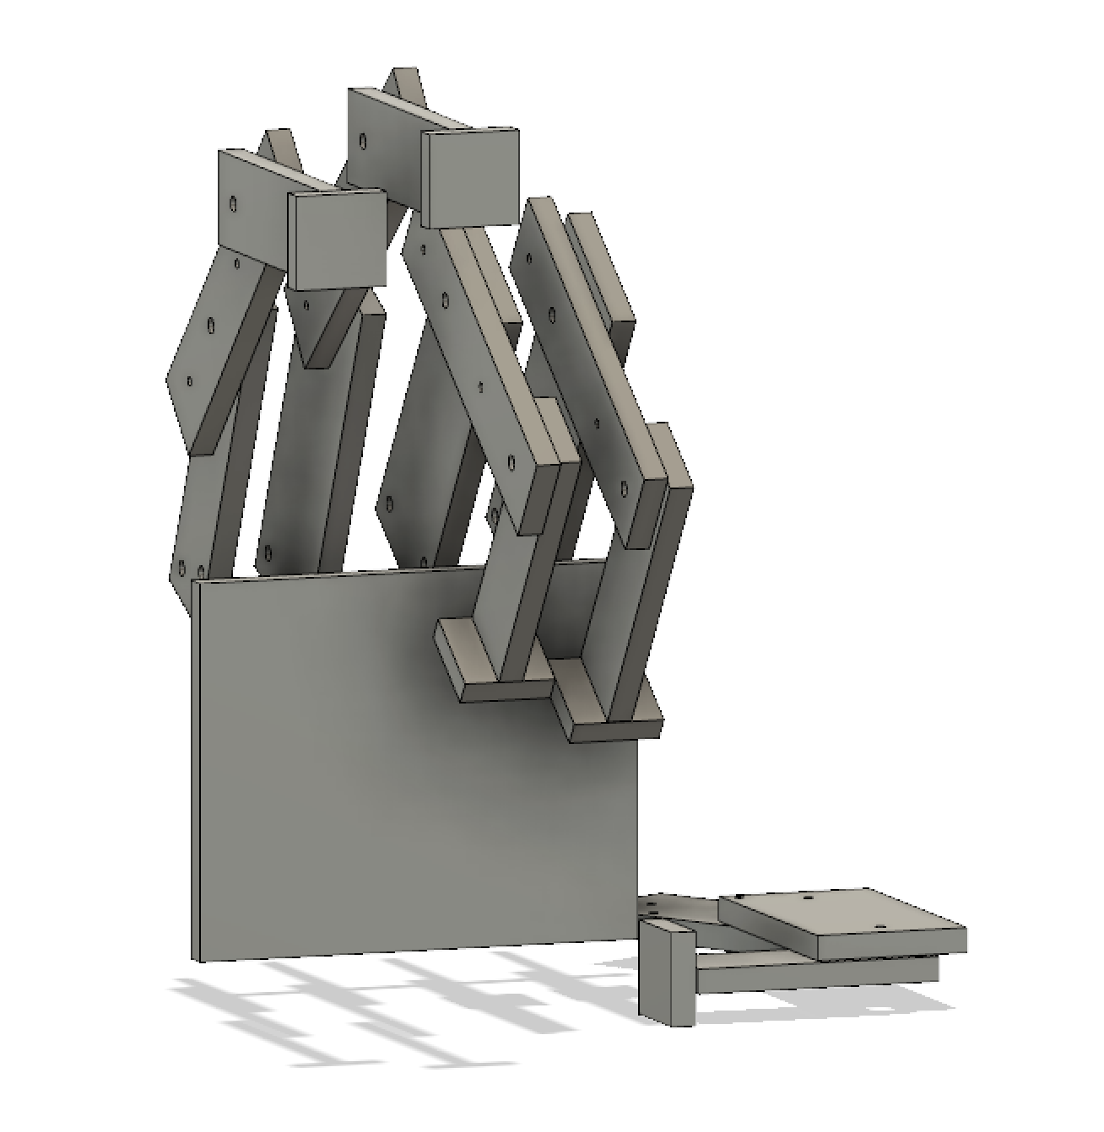
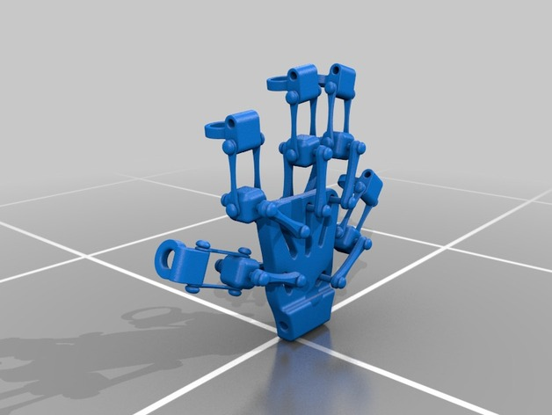
PROJECT OVERVIEW
Background
Figure 1. Robotic Hand Figure 2. Exoskeleton
Handi-glove is a wearable assistance device that will allow users to control a robotic arm via an exoskeleton, while receiving temperature, sense of touch, and motion restraint feedbacks. Similar projects on the market include Robo-Glove, a wearable device designed by GM and NASA to help reduce the grasping force exerted by workers when working long periods of times, but most projects do not include as many feedbacks as our project does. The purpose of our project is to enhance safety standards in industrial and research environments, it allows users to physically interact with objects that could potentially be dangerous to the human skin in a safer manner.

Slide 4
PSSCS
PSSC #1: An ability to get user’s fingers position information with position sensors on the glove
PSSC #2: An ability to communicate microcontroller with servos and control the movement of robotic fingers
PSSC #3: An ability to output heating or cooling feedback based on the readings provided by temperature sensors on the robotic hand
PSSC #4: An ability to provide touch feedback based on the readings provided by pressure sensors on the robotic hand
PSSC #5: An ability to return robotic hand to standby posture after user taking off the control glove

Slide 5
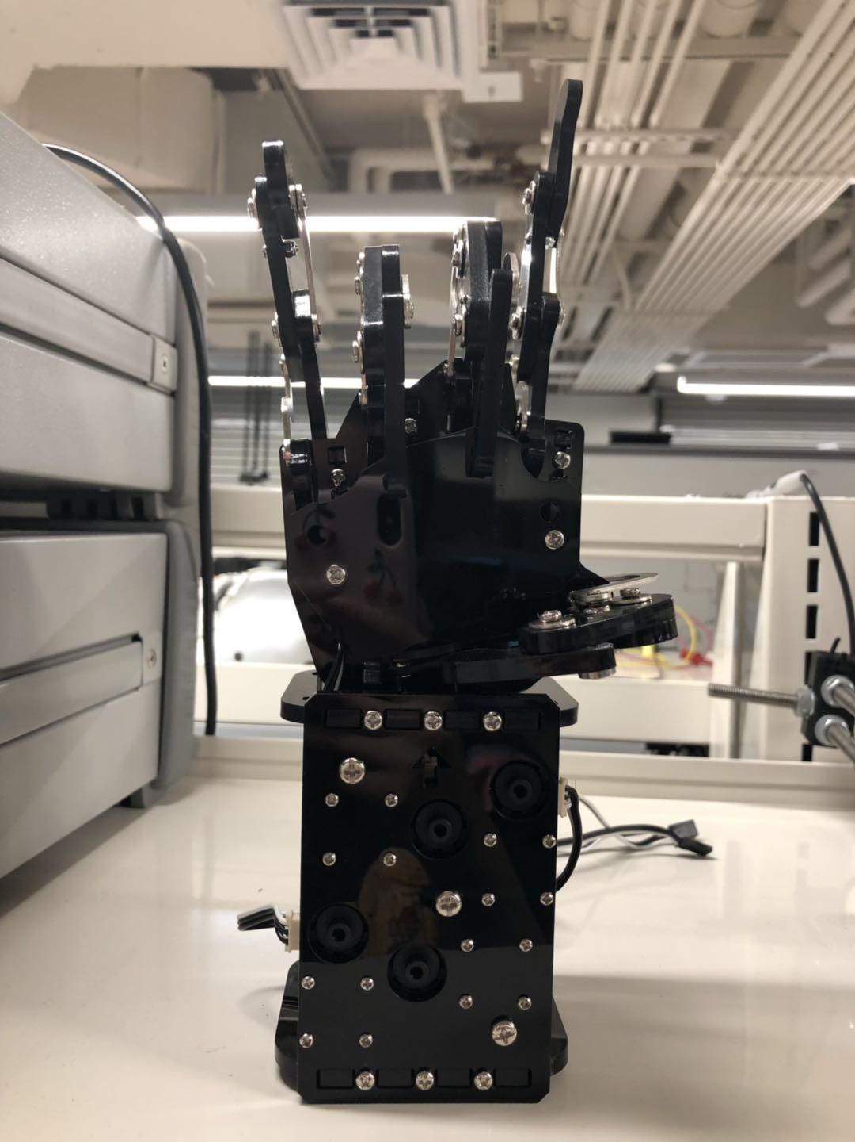
MAJOR COMPONENTS
Robot Hand
Robot Hand
Size (cm): 30.5*15*5
Weight (kg): 1.36
Material: plastic
Motor Operating Voltage: 12V
Description:
This robot hand is chosen because of its solid mechanical build. Also, it has 5 servo motors integrated which reduced the unnecessary burden on our team. The built-in servo’s specification is close to our prototyping servo motors which reduce redundant work.
Notes:
The first major component is robot hand with the size of 30.5 by 15 inches. We choose this robot hand because of its high quality mechanical build. Also, the servo motors that come in the box which is really close to our design requirement therefore it can significantly reduce our pressure on the hardware side.

Slide 6
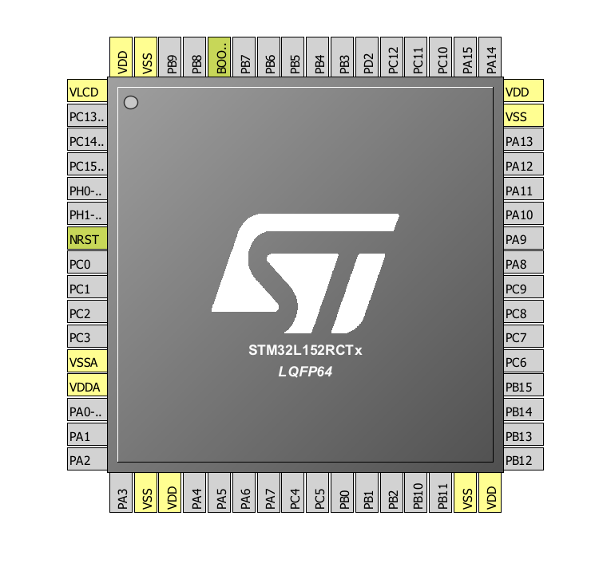
MAJOR COMPONENTS
STM32L152
STM32L152
CLK: 2.097 Mhz
I/O Ports: 144, 32 MHz
ADC: 21*12-bits
DAC: 2*12-bits
TIMER: 6*16-bits
SPI: 2*16-Mbits /s
USART: 3 lines
Description:
STM32L152 is chosen as the MCU because it has all the required peripherals with enough I/O ports. Also, the speeds of SPI are fast enough for any transmission. What’s more, STM32L152 has a comparatively large number of pins that can be really helpful for software development.
Notes:
All the devices offer a 12-bit ADC, 2 DACs and 2 ultra-low-power comparators, six general-purpose 16-bit timers and two basic timers, which can be used as time bases. Moreover, the STM32L152 devices contain standard and advanced communication interfaces: up to two I2Cs and SPIs, three USARTs and a USB.
STM32L152 is chosen as the MCU because it has all the required peripherals with enough I/O ports. Also, the speeds of SPI are fast enough for any transmission. What’s more, STM32L152 has a comparatively large number of pins that can be really helpful for software development.

Slide 7
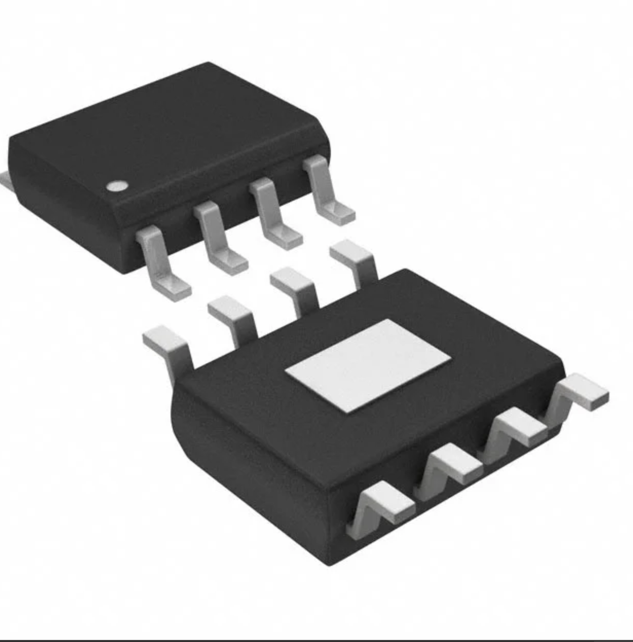
MAJOR COMPONENTS
H-bridge Motor Driver
DRV8871 H-BRIDGE DRIVER
size: 4.9 × 6 mm
Peak Current:3.6-A
Voltage: 6.5-V to 45-V Operating Voltage
2-PWM Control Interface
Description:
LM298N is used as the motor driver for both the temperature feedback system and force feedback system.
Notes:
The DRV8871 device is a DC motor driver for small machines. Two logic inputs control the H-bridge driver, which consists of four N-channel MOSFETs that can control motors with up to 3.6-A peak current. The 2PWM can control motor speed. Setting both inputs low enters a low-power sleep mode. This solution uses a standard low-cost, low-power resistor to set the current within the limit. The ability to limit current can significantly reduce the system power requirements.

Slide 8
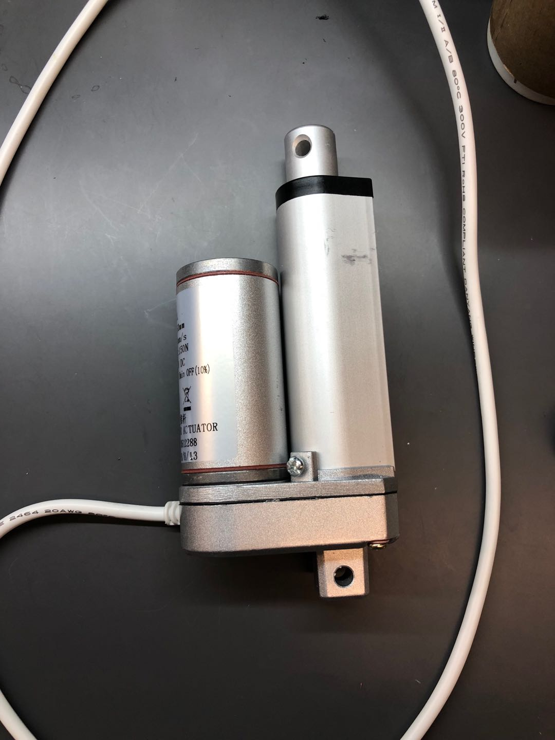
MAJOR COMPONENTS
Linear Actuator
DC Linear Actuator
Input Voltage: 12VDC
Stroke : 50mm
Push Load: 150N
Duty Cycle: 10%
current: 1A*5
power：60W
Description:
A 12V linear actuator is chosen as the pressure feedback component. Which are provide the air pressure to the finger.
Notes:
The next one is linear actuator. A 12V linear actuator is chosen as the pressure feedback component. Which are provide the air pressure to the finger.

Slide 9
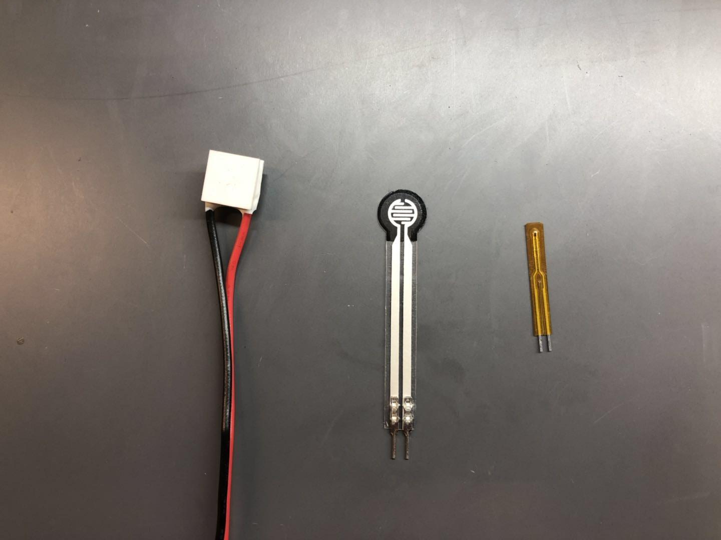
MAJOR COMPONENTS
Sensor and Cooler components
from left to right:
Peltier module:
Maximum Voltage : 0.8V
Maximum Current：3.3A
Range of temperature: -50C~100C
Description:The Peltier module is able to freeze or heat when flips the polarity of a power source. The module can also be attached to the fingertips of the glove to become a part of the temperature feedback system.
Pressure sensor
Temperature sensor
Notes:
from left to right:
Peltier module珀尔帖:
The Maximum Voltage is 0.8V which is not a common module but which is much accurate for our project
Maximum Current is 3.3A
Range of temperature: -50Celsius~100C saleseeyesThe module can also be attached to the fingertips of the glove to become a part of the temperature feedback system.
The size of these 3 major components are very small which is build on our robot hand and control glove .**0.8V is NOT a common model, most projects use 1-3V, we selected 0.8 bc it is accurate

Slide 10
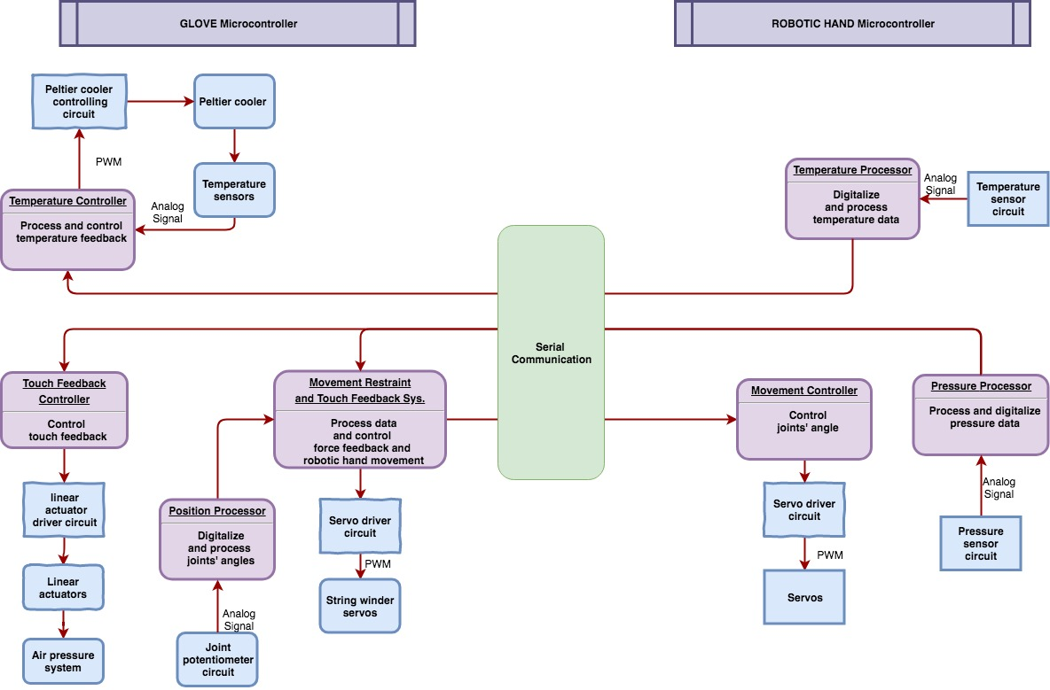
BLOCK DIAGRAM

Slide 11
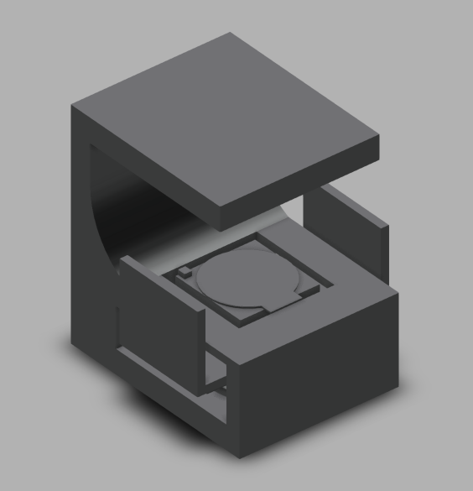
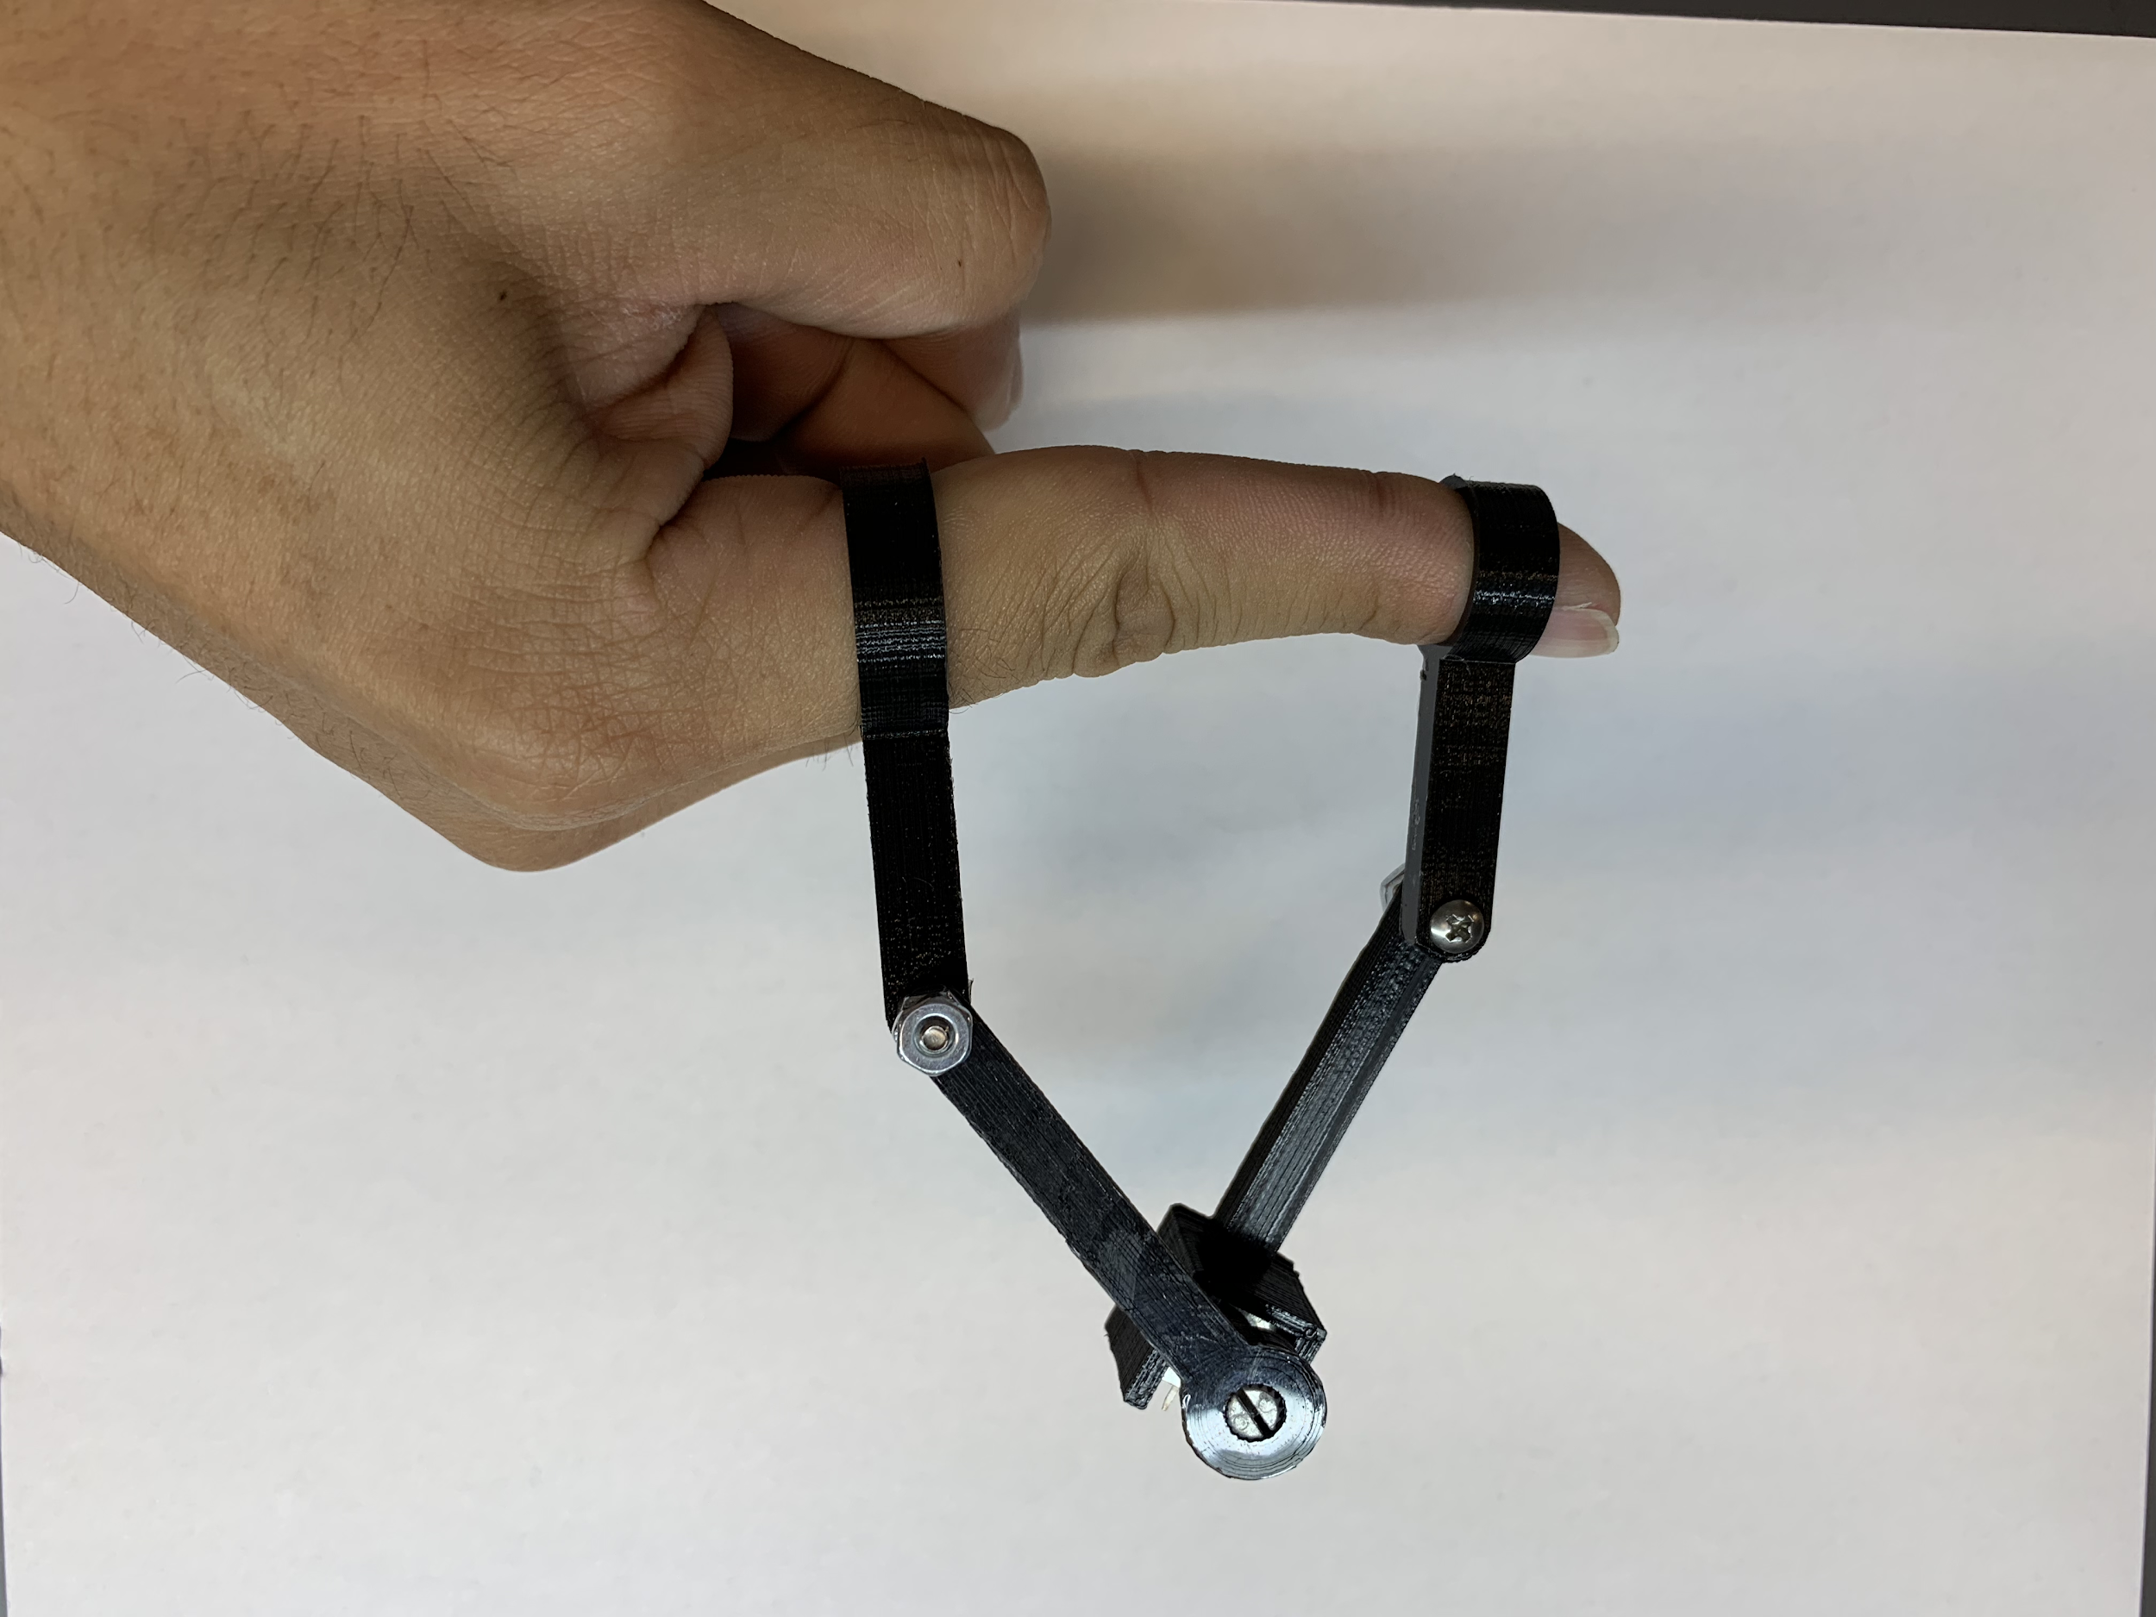
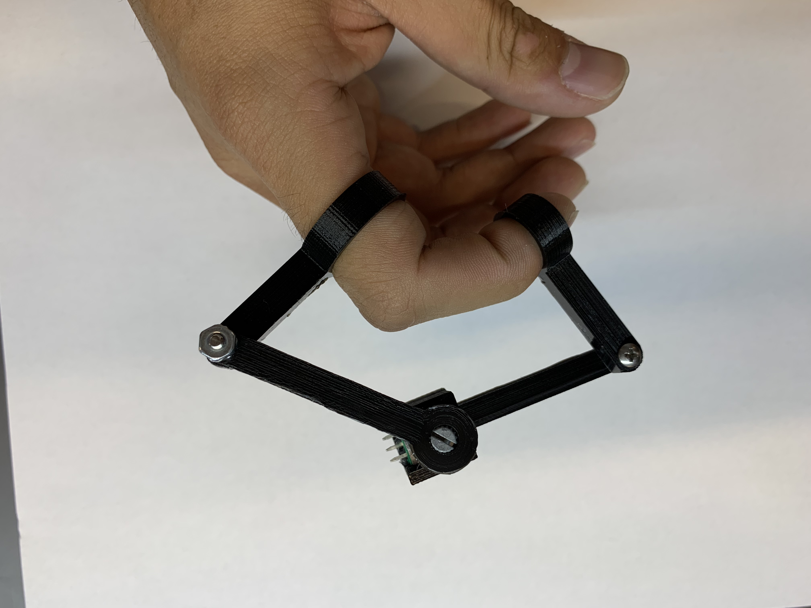
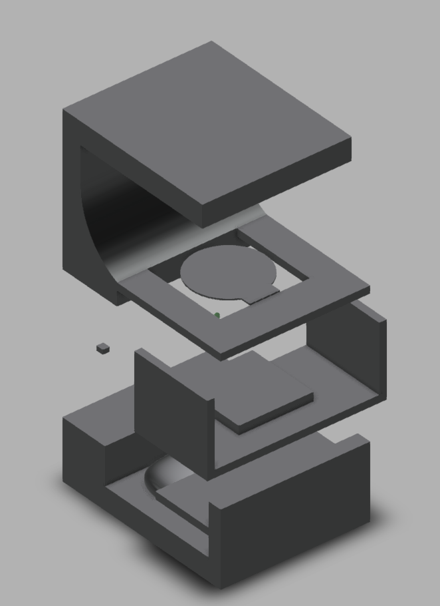
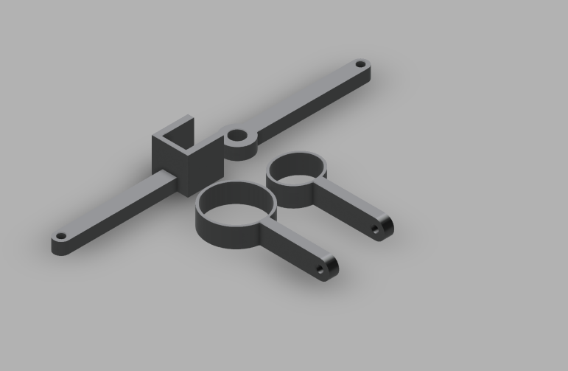
PACKAGING DESIGN
Pressure Sensor
Peltier Cooler
Temperature Sensor
Airbag

Slide 12
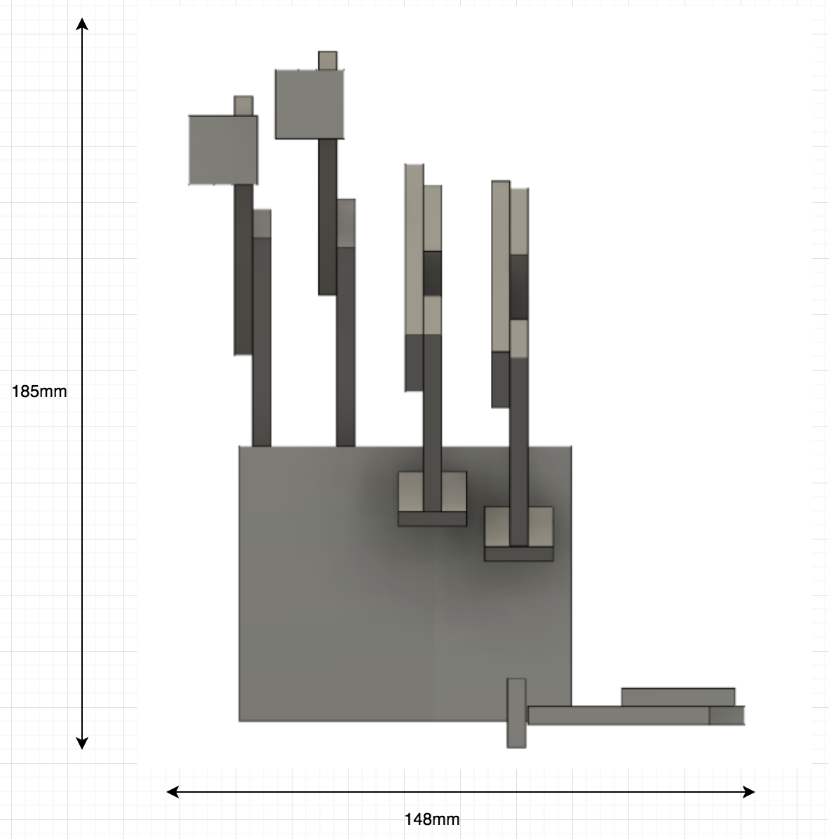
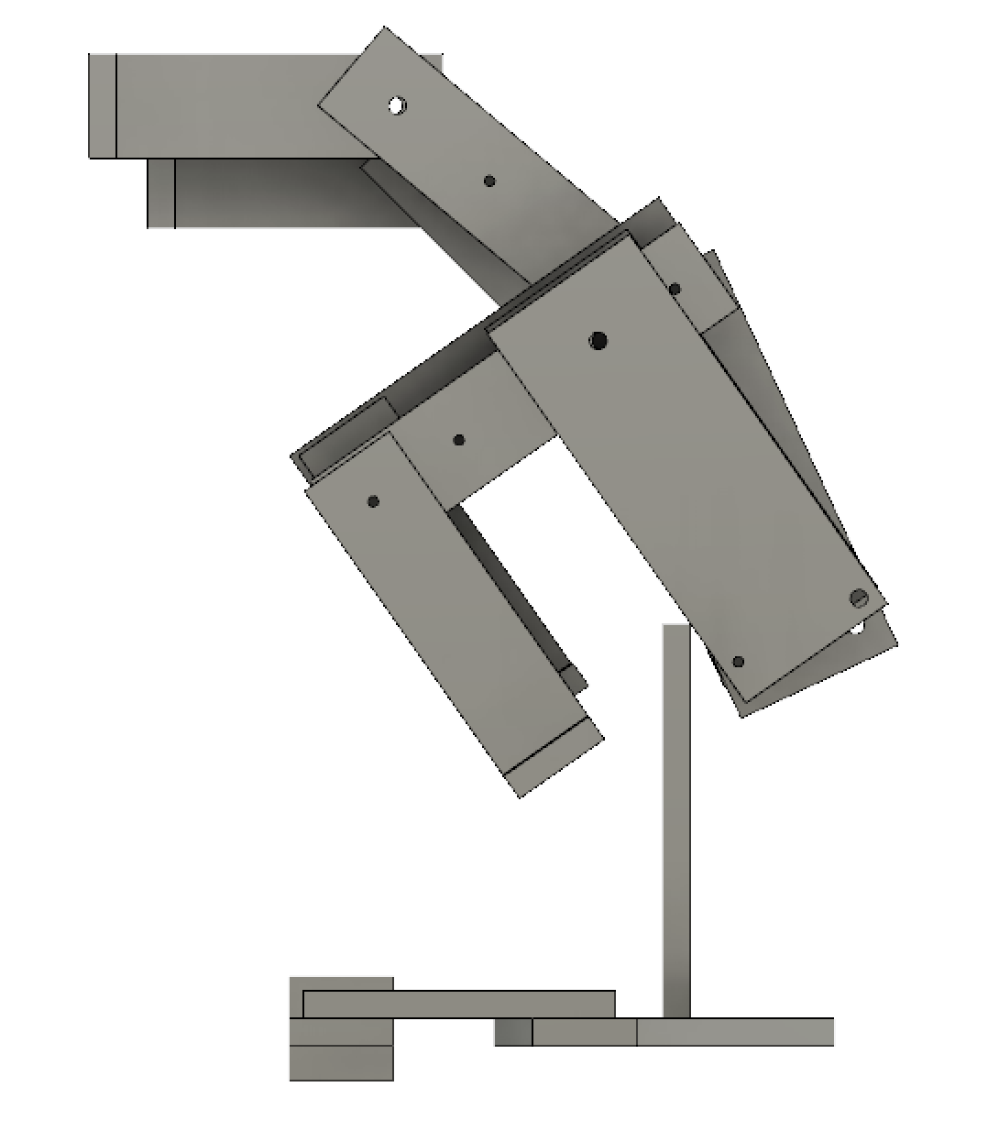
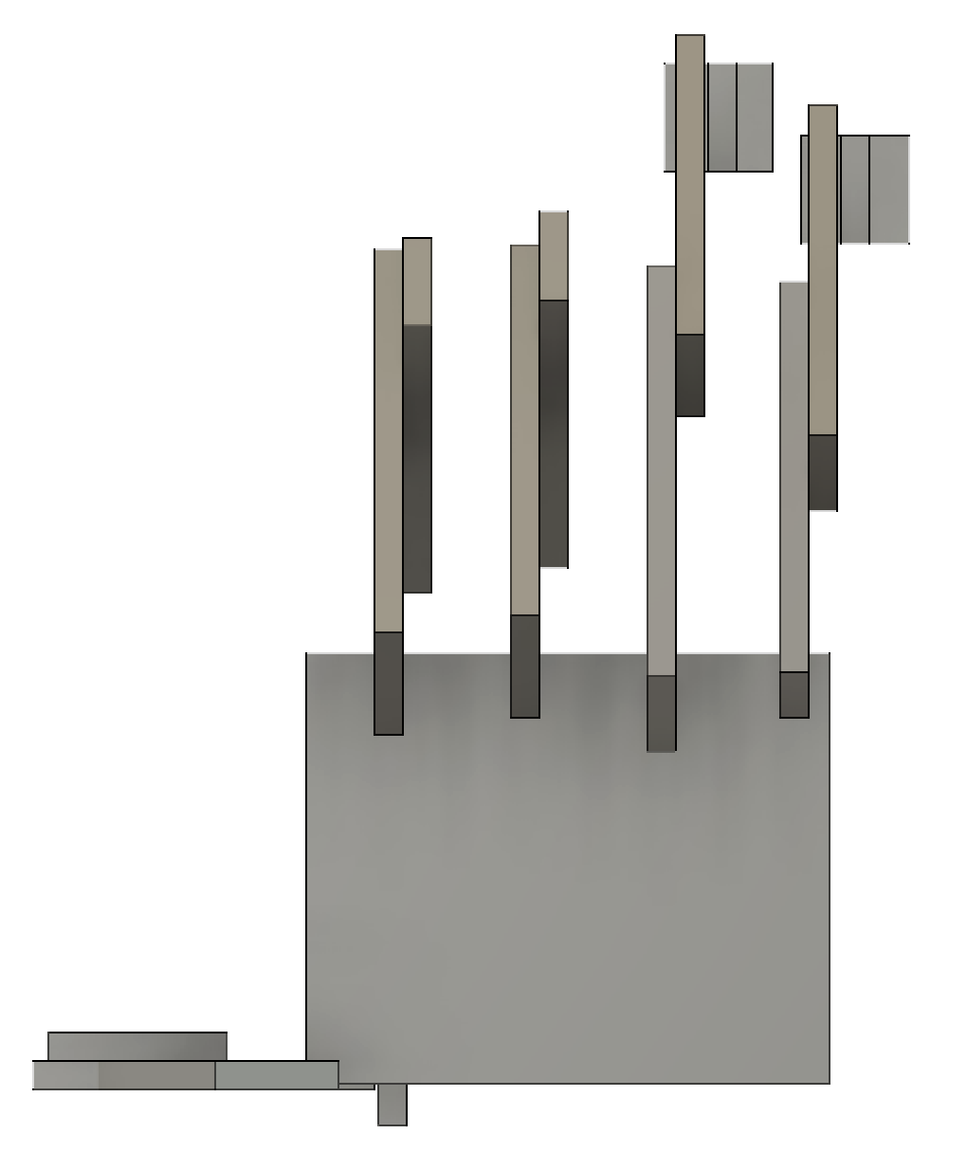
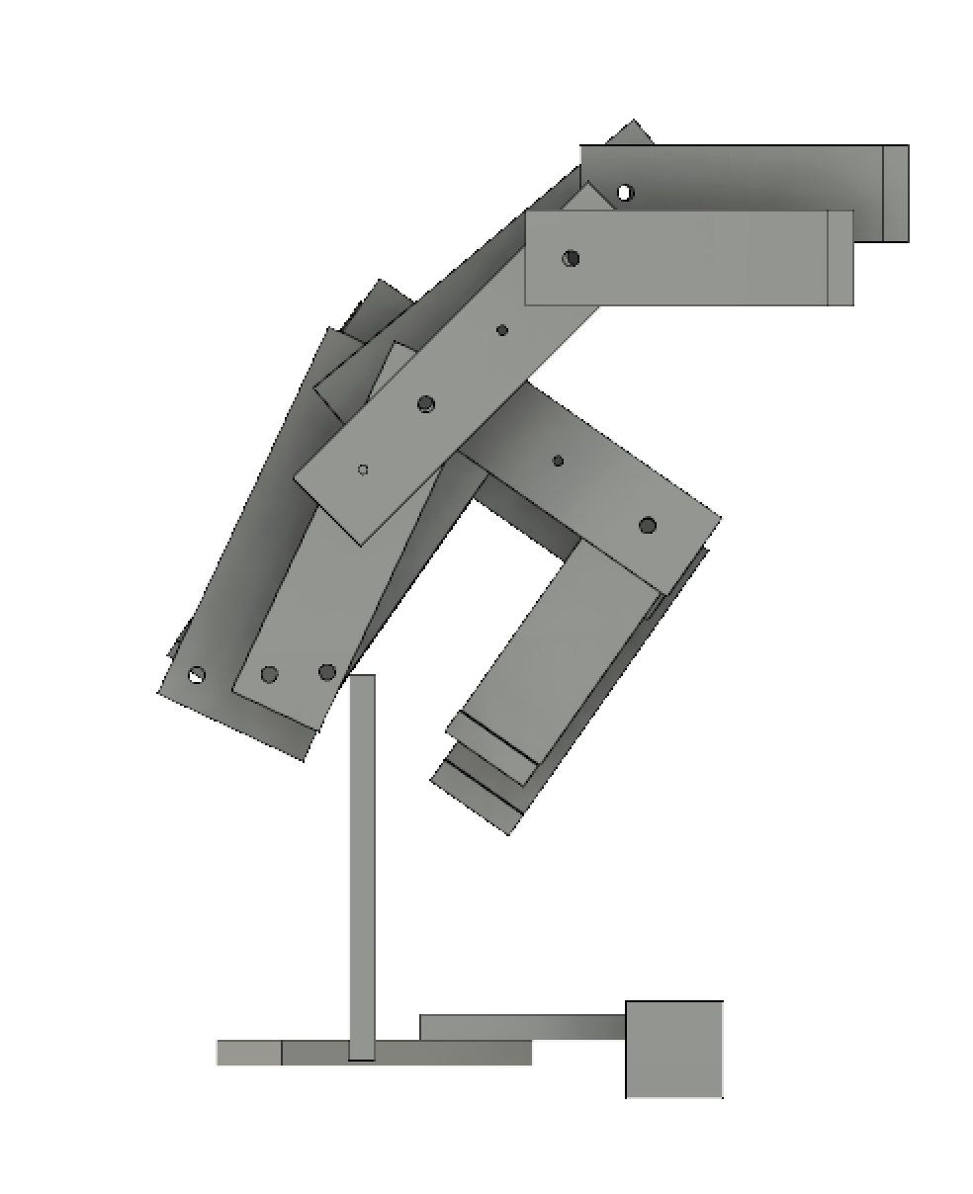
PACKAGING DESIGN
Temperature sensor and Pressure Sensor
placement pad

Slide 13
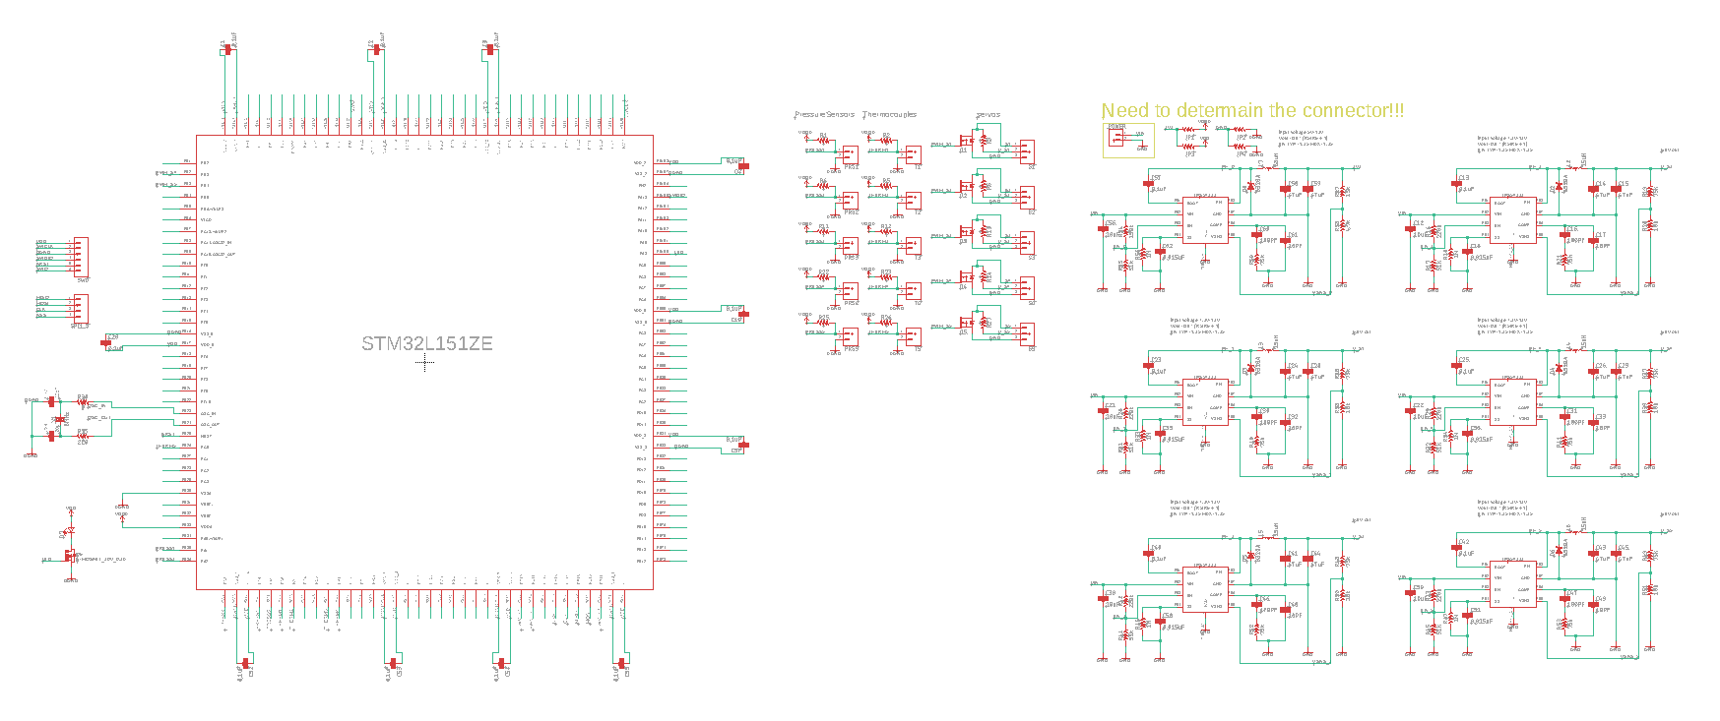
ELECTRICAL SCHEMATIC
Overview

Slide 14
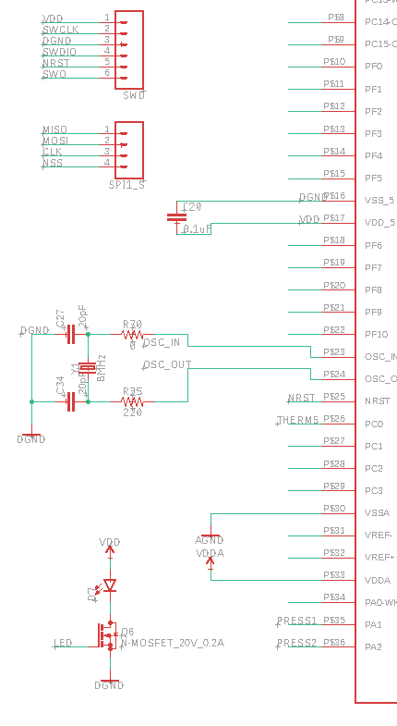
ELECTRICAL SCHEMATIC

Slide 15
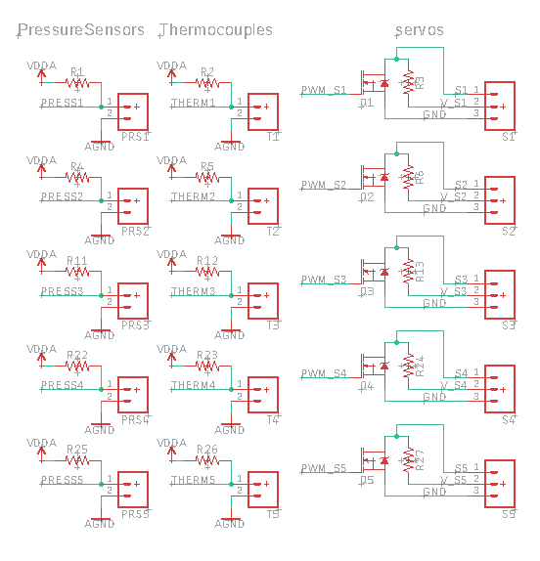
ELECTRICAL SCHEMATIC

Slide 16
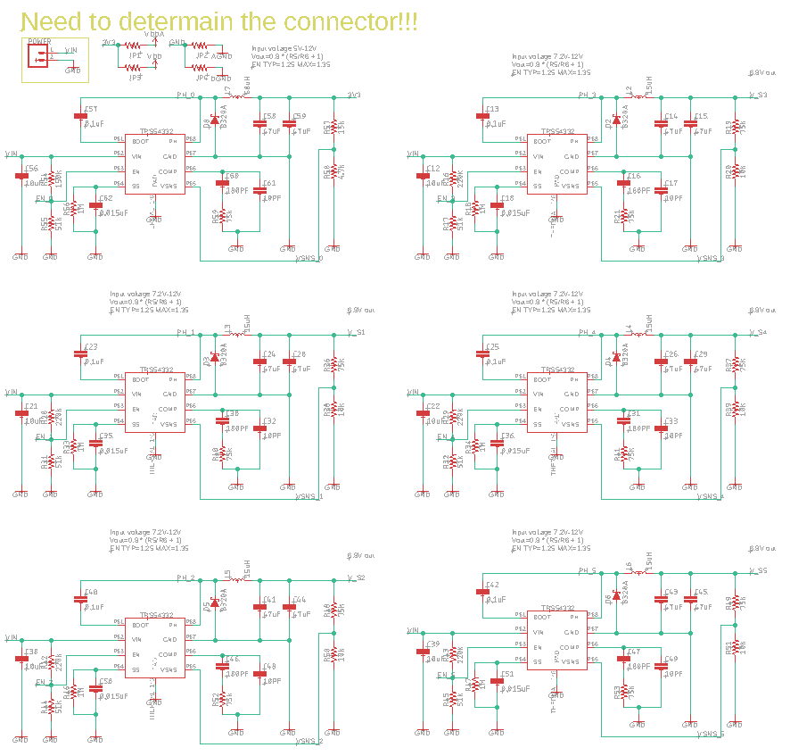
ELECTRICAL SCHEMATIC

Slide 17
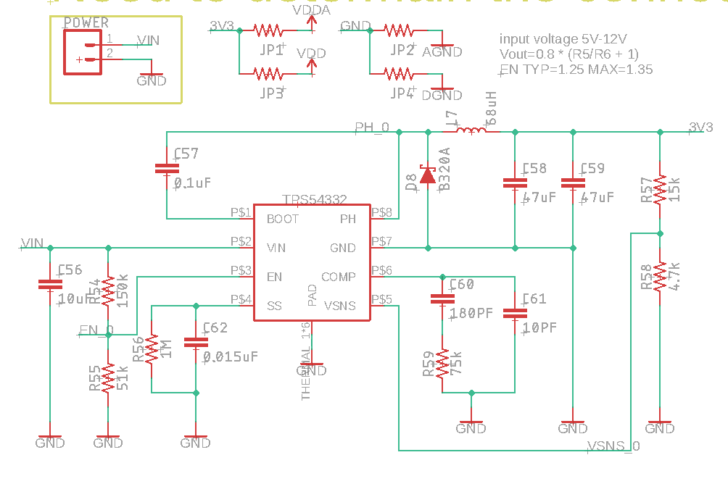
ELECTRICAL SCHEMATIC

Slide 18
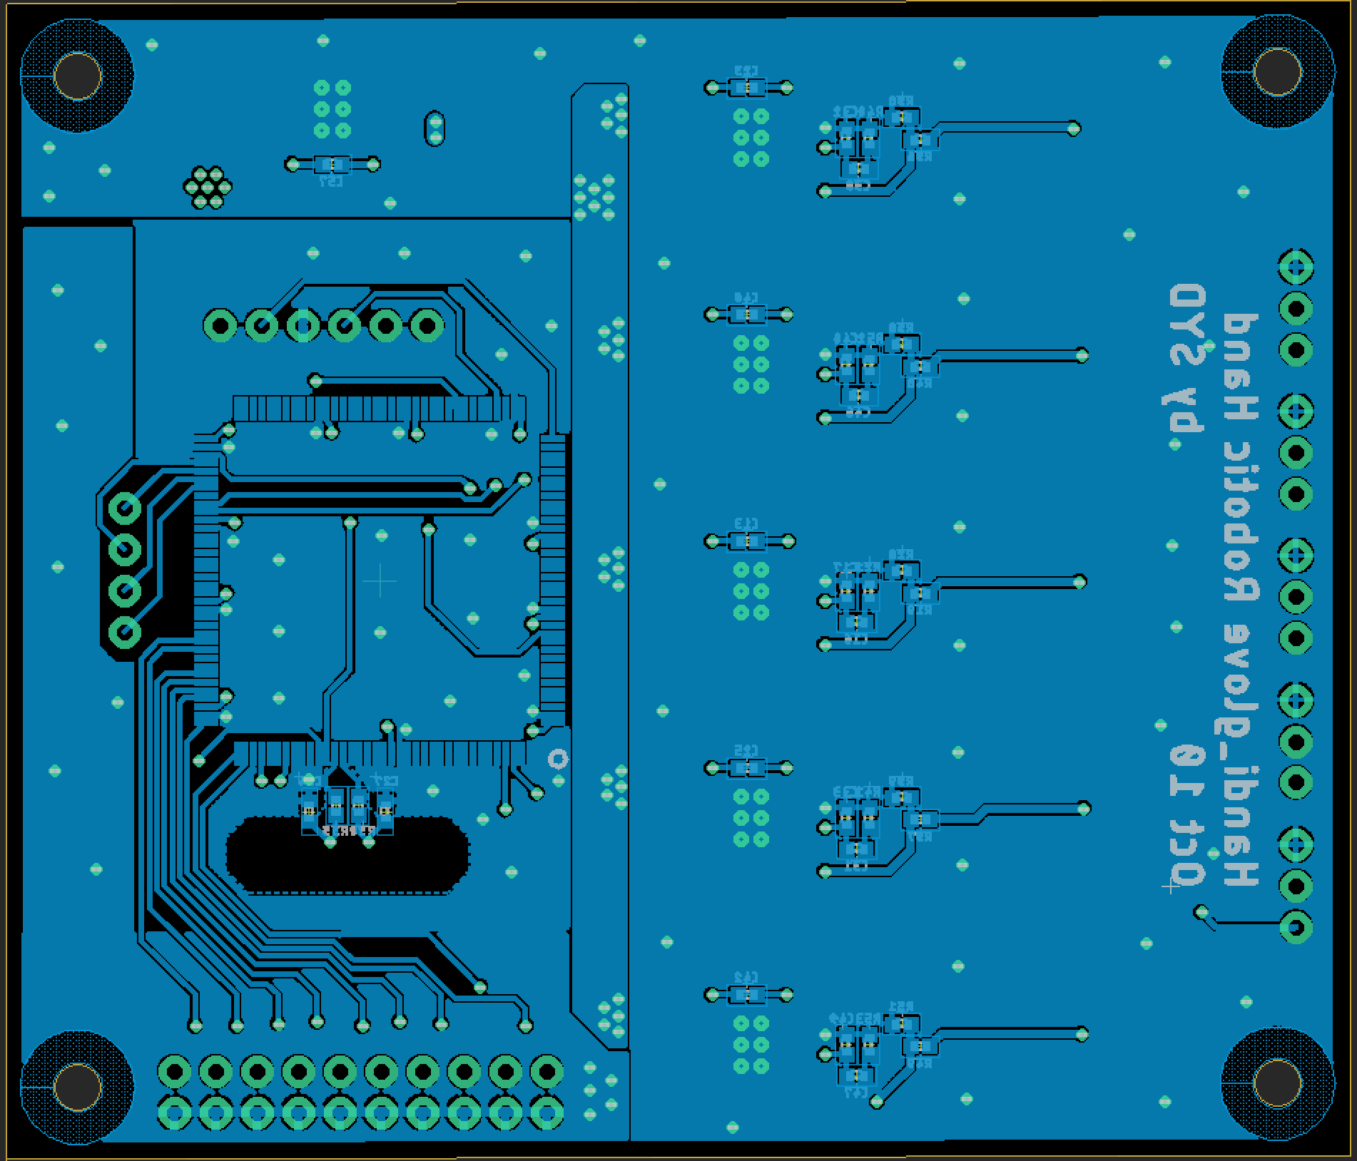
PCB LAYOUT

Slide 19
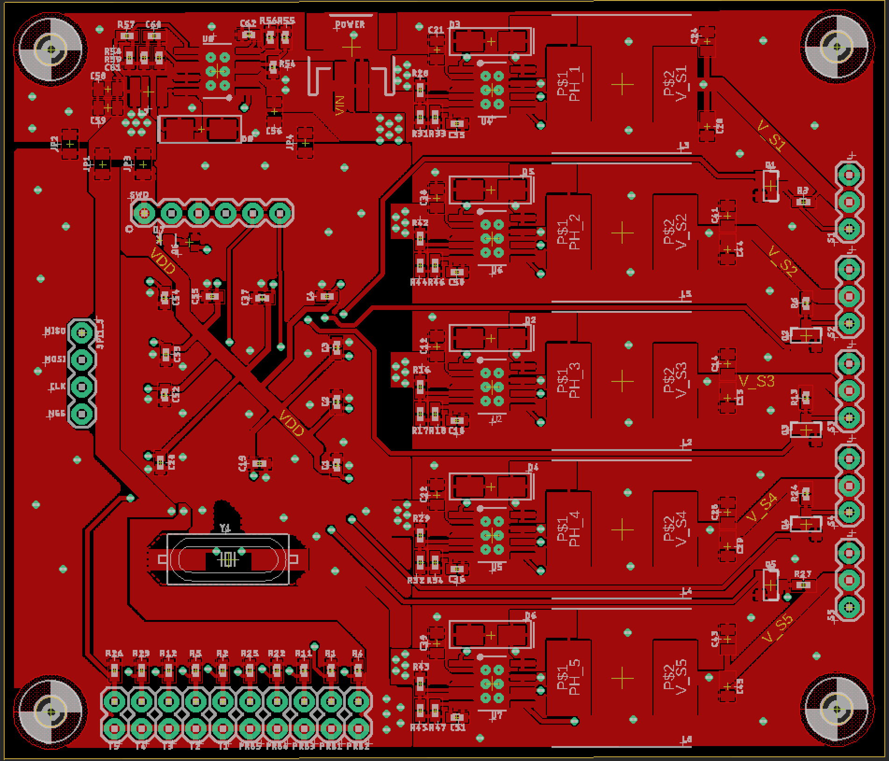
PCB LAYOUT

Slide 20
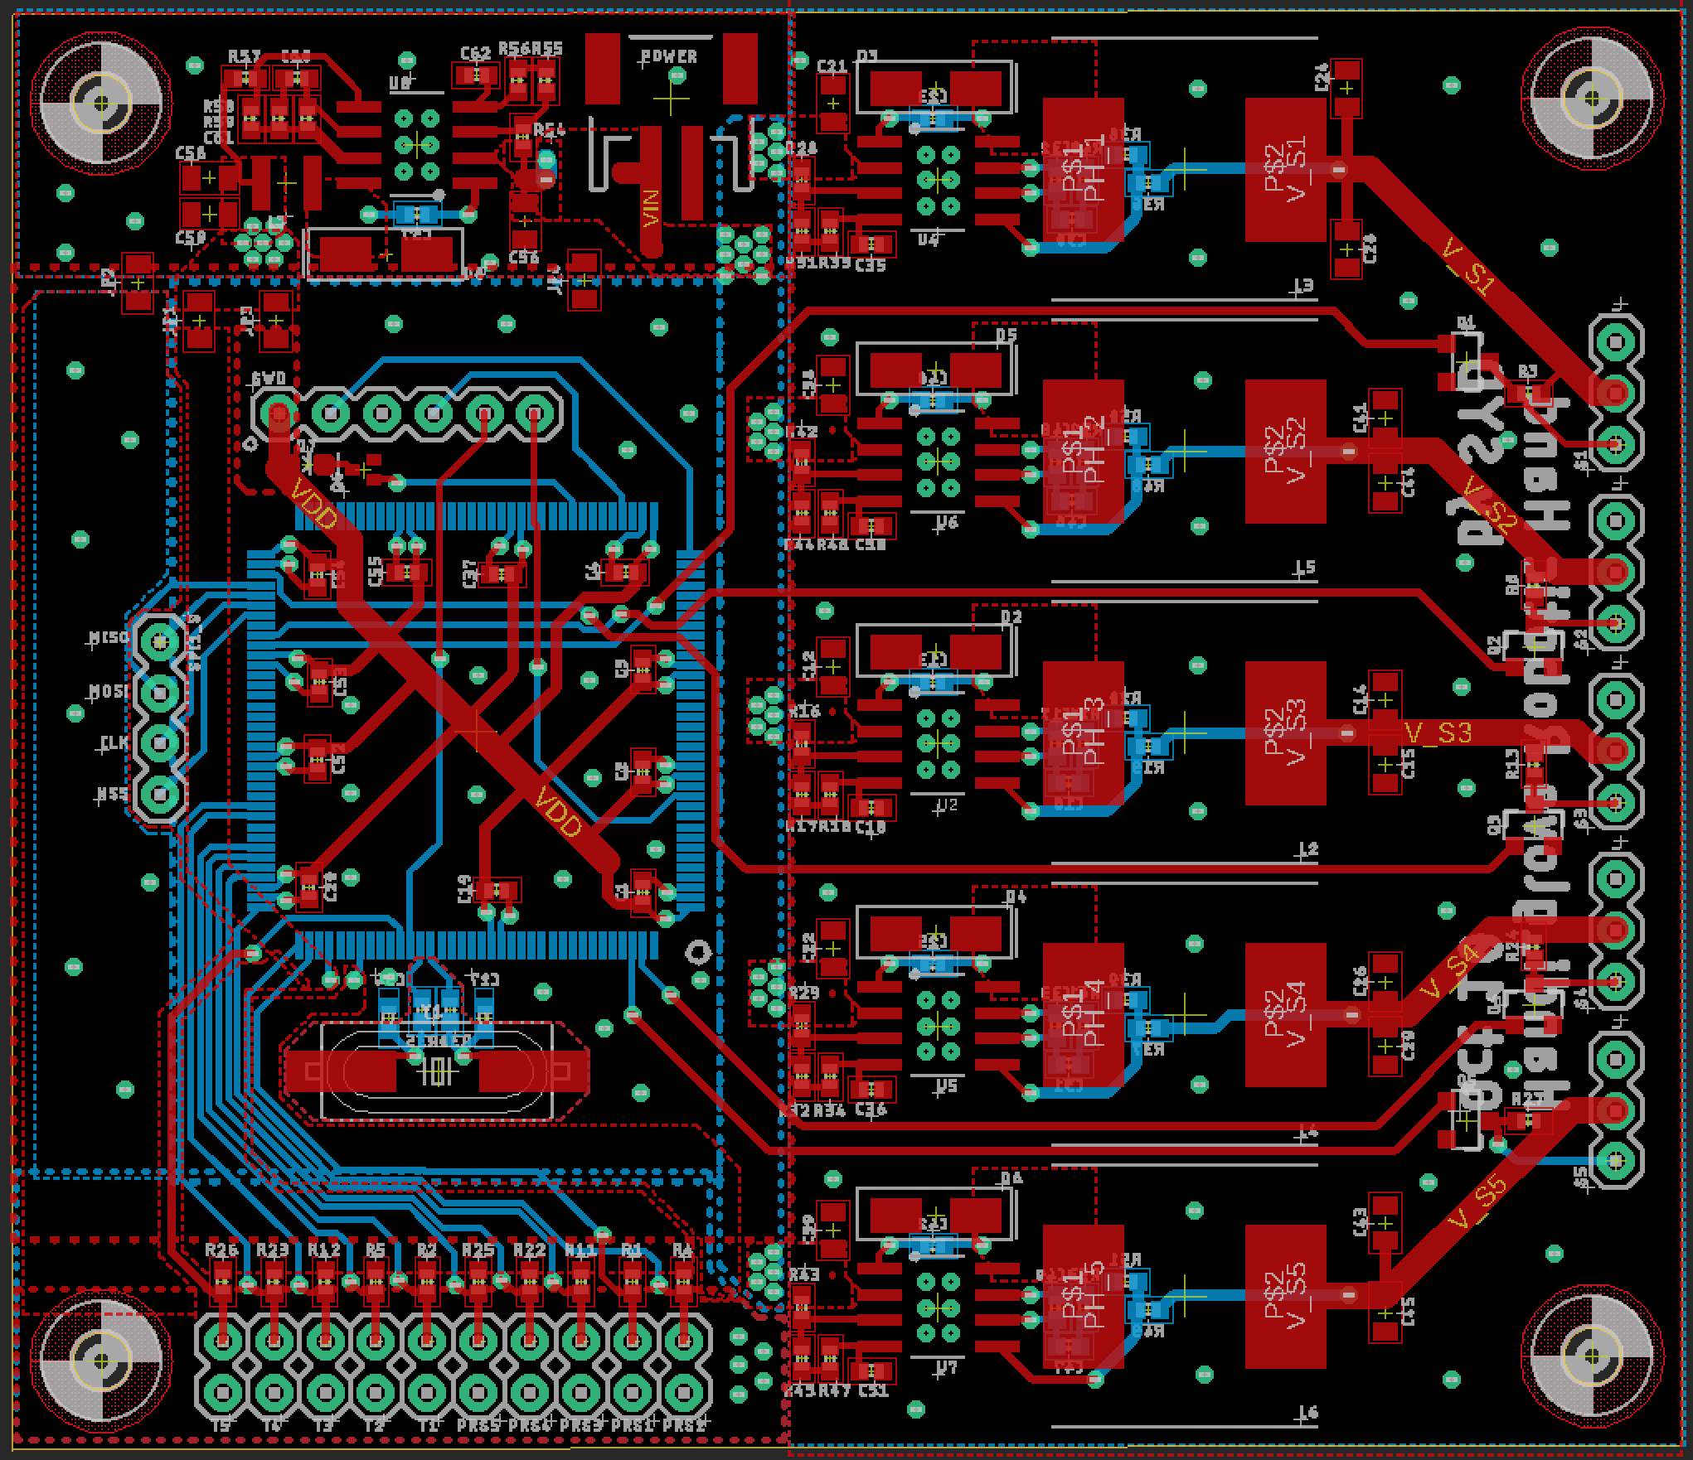
PCB LAYOUT
With Polygon

Slide 21
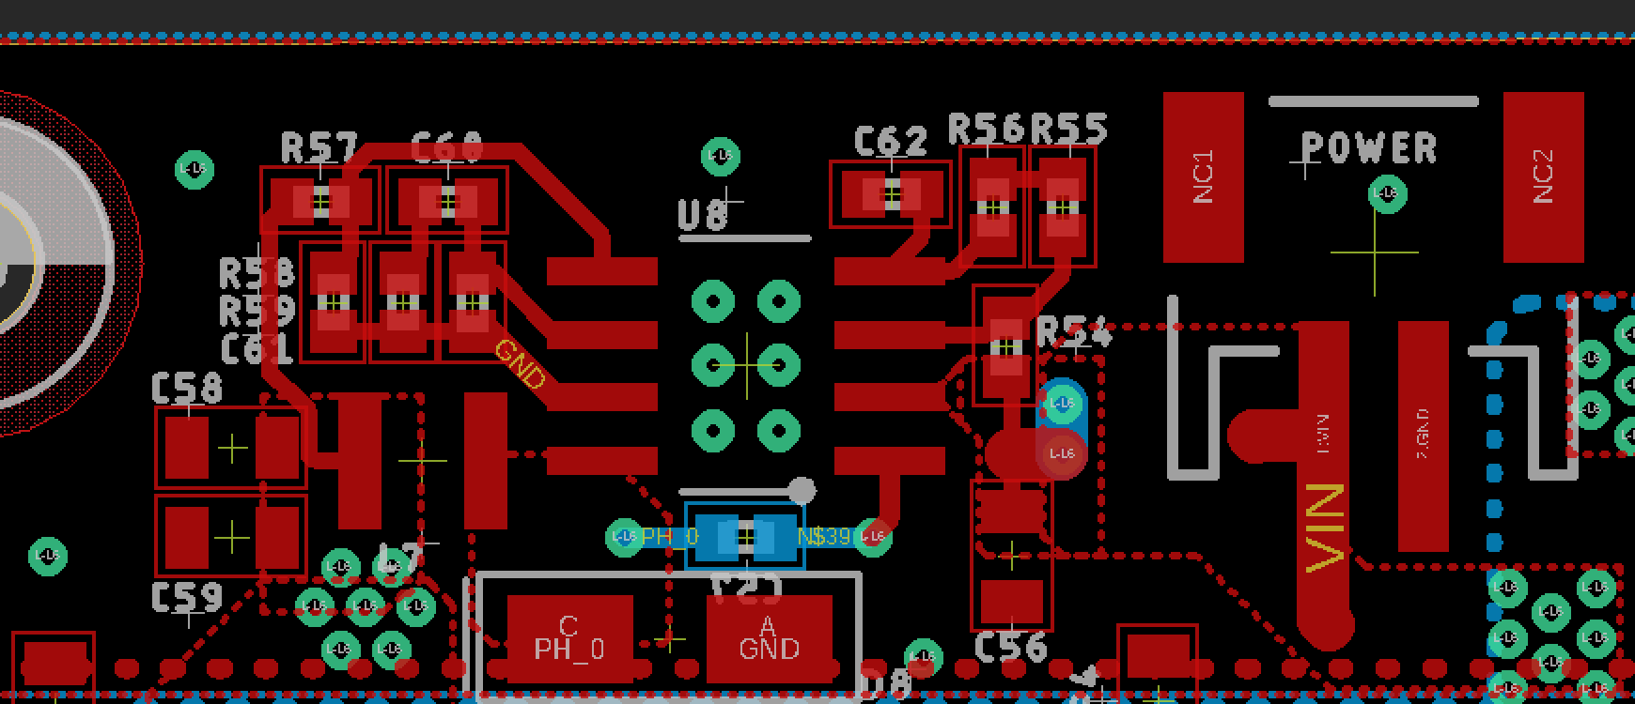
PCB LAYOUT
part1

Slide 22
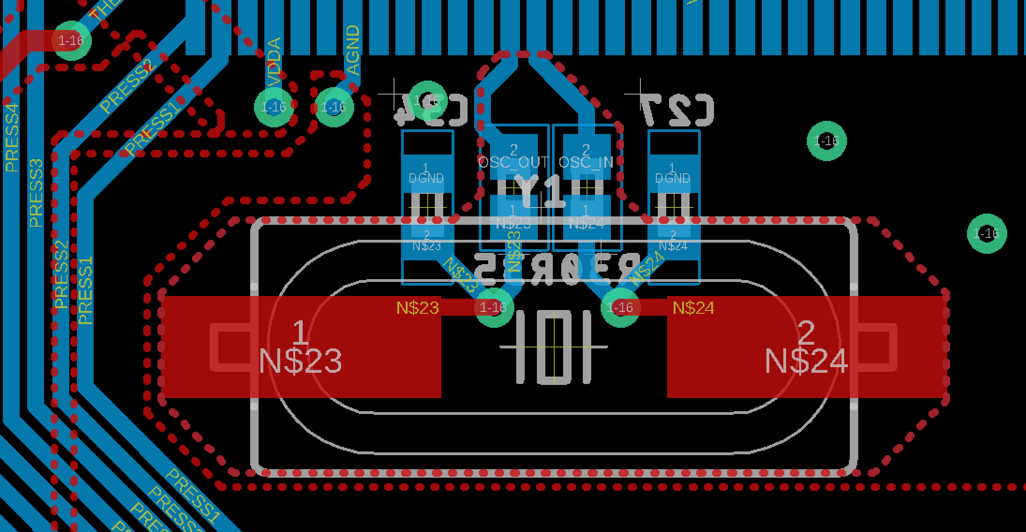
PCB LAYOUT
part2

Slide 23
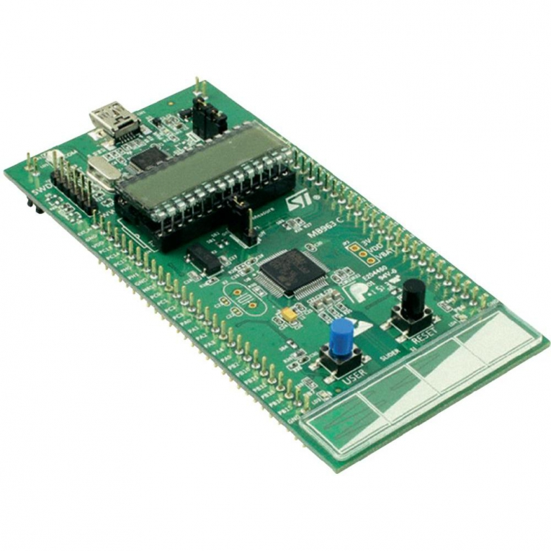
PROTOTYPING PROGRESS
In Progress
Communication Protocol
Slave
Master
SPI
Robot uC
Glove uC
Notes:
We implement the SPI to communicate between two boards. The one on the glove serves as the master whereas the one on the robot hand serves as the slave. The timer interrupt triggers SPI communication every few milliseconds. The master sends the finger position to the slave on MOSI line while the slave sends out the temperature and pressure value through MISO line. This part

Slide 24
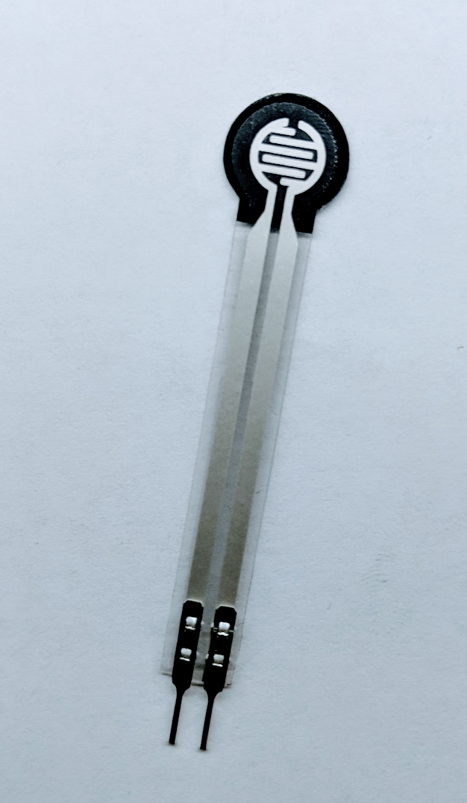
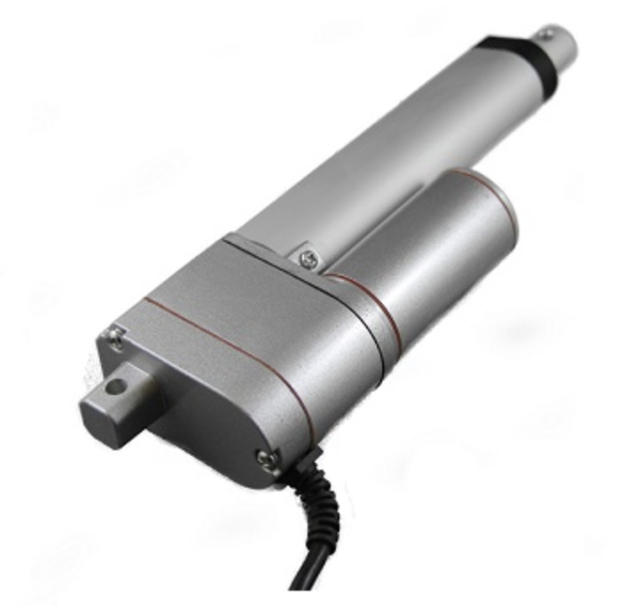
PROTOTYPING PROGRESS
In Progress - Working on generating pressure via Linear Actuator
Pressure Feedback
ADC
SPI
Logic
Pressure Sensor
Robot uC
Glove uC
Linear Actuator

Slide 25
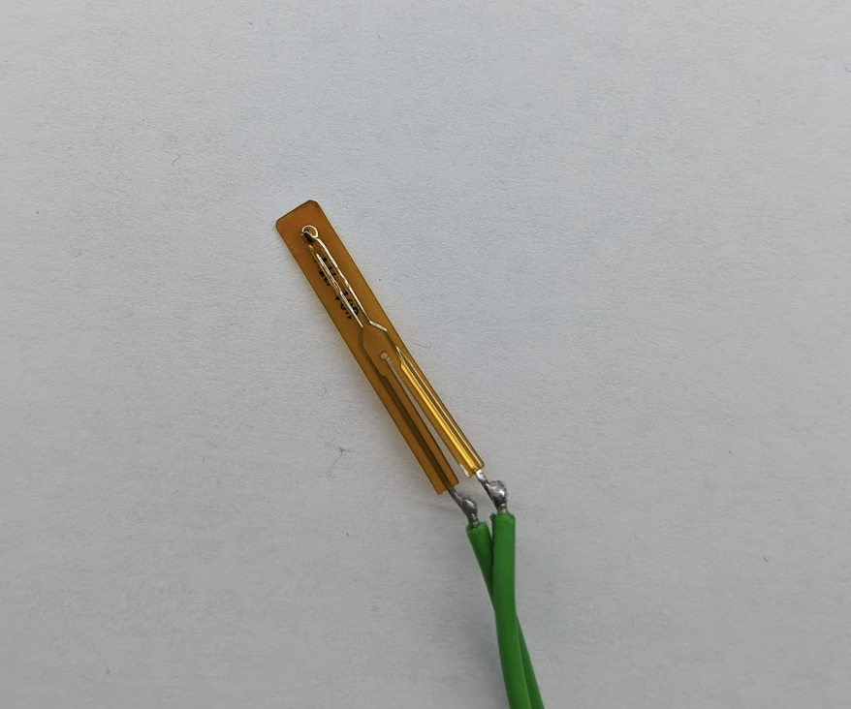
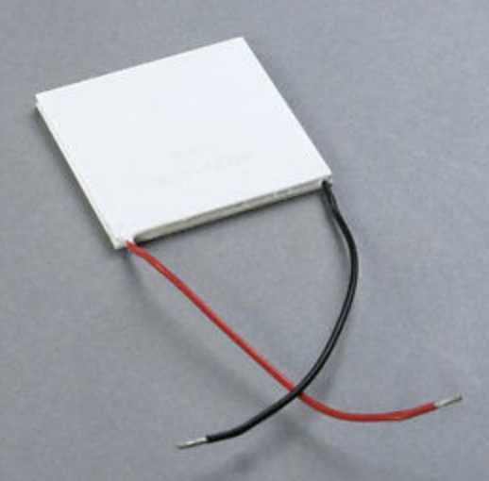
PROTOTYPING PROGRESS
Untested - 2 PWMs to generate Heating/Cooling effect
Temperature Feedback
ADC
SPI
PWM
Temperature Sensor
Robot uC
Glove uC
Peltier Cooler
Video Demonstration

Slide 26
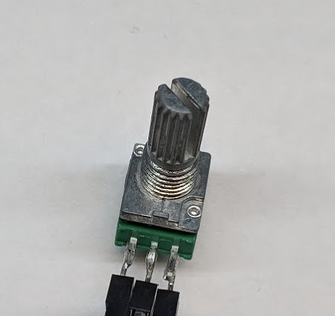
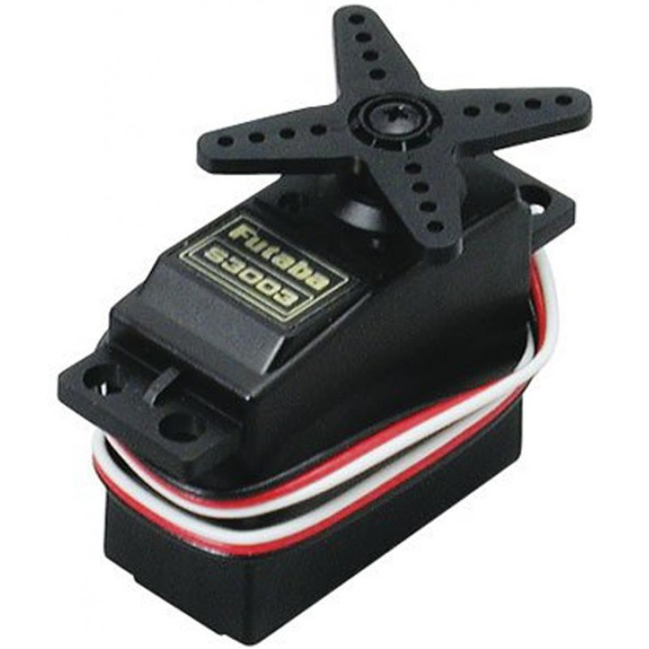
PROTOTYPING PROGRESS
Completed
Motion Control
ADC
SPI
PWM
Potentiometer
Glove uC
Robot uC
Servo
Video Demonstration

Slide 27
PROTOTYPING PROGRESS
In Progress
Motion Restraint
ADC
SPI
PWM
Pressure Sensor
Robot uC
Glove uC
Servo

Slide 28
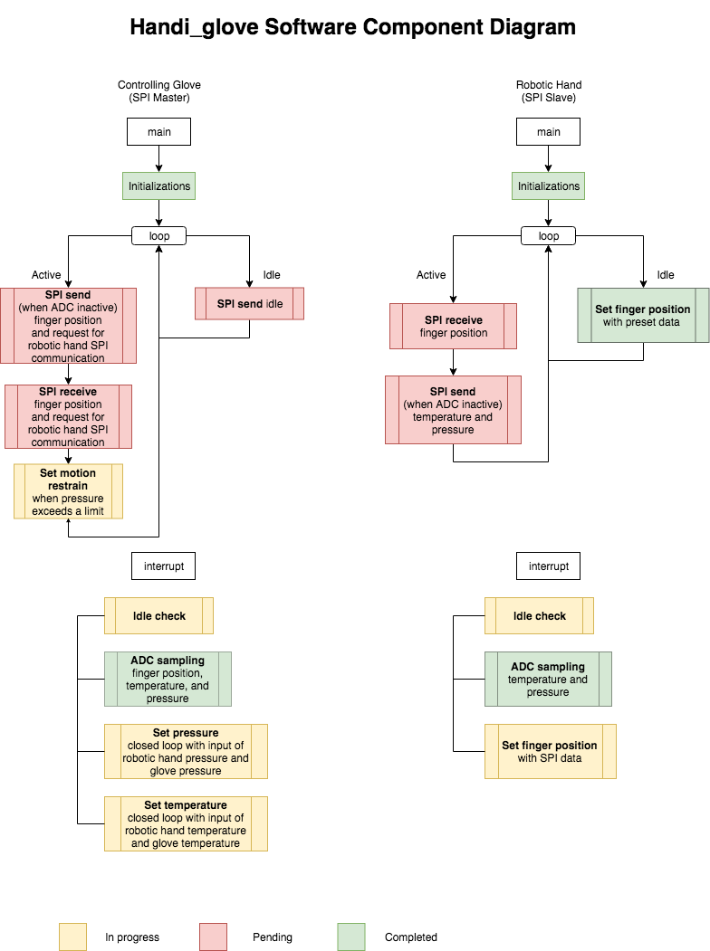
SOFTWARE DEVELOPMENT STATUS
Overall Software Development

Slide 29
SOFTWARE DEVELOPMENT STATUS
Glove’s STM32L152
Heat and Touch Feedback (In Progress)
Generate desire temperature effect and expand airbag based on data transmitted from the other microcontroller.
Motion Restraint (In Progress)
Control servo to generate a restraint effect on glove.
Send Robot Hand SPI (Pending)
Send potentiometer value to the other side to control robotic hand’s movement.
Request SPI from slave (Pending)
Receive sensor value from robotic finger to implement feedback system and motion restraint.

Slide 30
SOFTWARE DEVELOPMENT STATUS
Robot Hand’s STM32L152
Sensor value ADC input (Complete)
Read various sensors’ analog input and convert them into digital signal.
Finger Motion (Complete)
Control servo to mimic hand gesture.
Restore fingers’ default position (Pending)
Move robotic finger back to initial position if glove is detected as empty.
Receive SPI from master (Pending)
Listen on master to receive incoming communication packet via SPI.

Slide 31
PROJECT TIMELINE
Detailed Project Timeline
Week 8 | Finish PCB design and sends out to manufacturer.
Week 9 | Finish pressure and temperature feedback system. Verify functionality with H-bridge.
Week 10 | Finish motion restraint program. Finish building exoskeleton.
Week 11 | Finish soldering the PCB and test each functionality. Finish coding restore initial position when glove is empty.
Week 12 | Finish communication between two microcontrollers.
Week 13 | System integration test and improvements.
Week 14 | Finalize the project and check for any bugs or improvements.
Week 15 | Final Showcase
Week 16 | Final Presentation

Slide 32
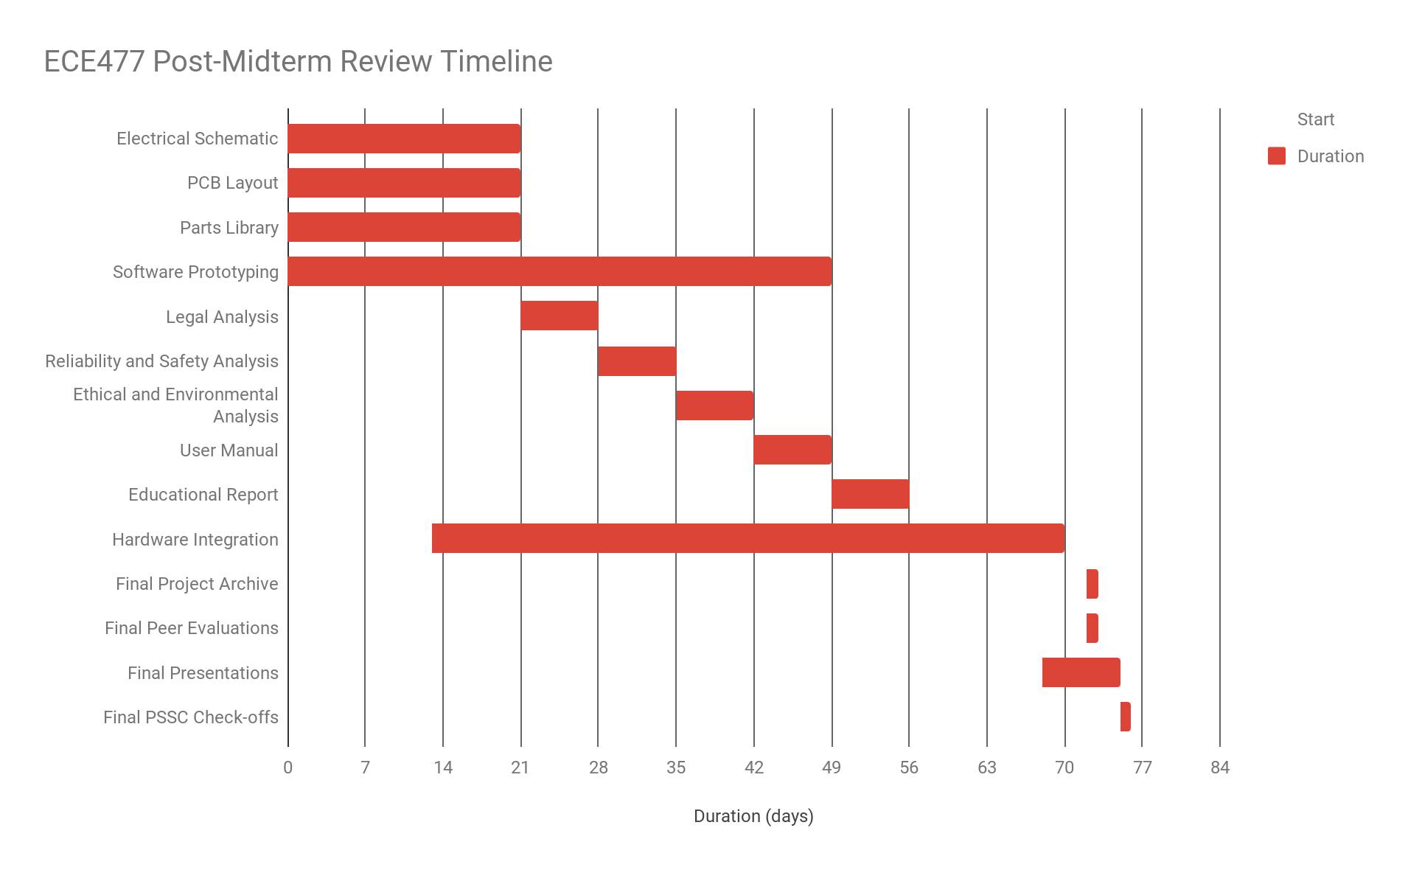
PROJECT TIMELINE
Week 6
Week 7
Week 8
Week 9
Week 10
Week 11
Week 12
Week 13
Week 14
Week 15
Week 16
Christmas
Sept. 28
Oct. 12
Oct. 26
Nov. 23
Dec. 7

Slide 33
3D PRINTING
Questions?

